Slide 1
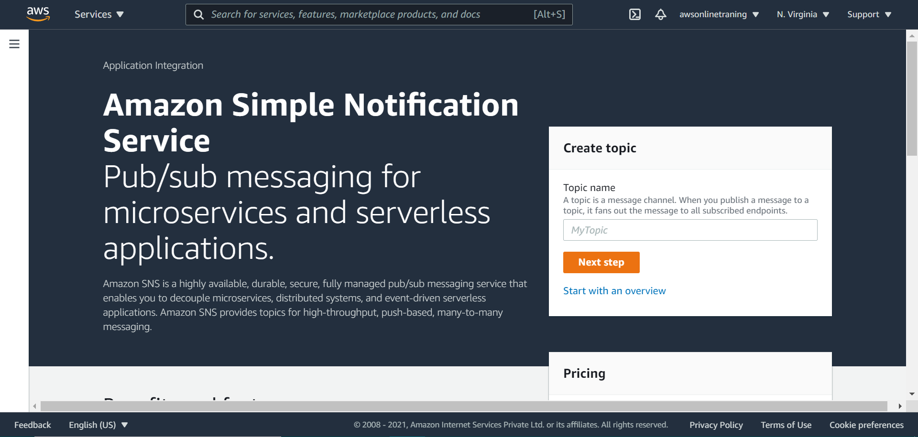

Slide 2
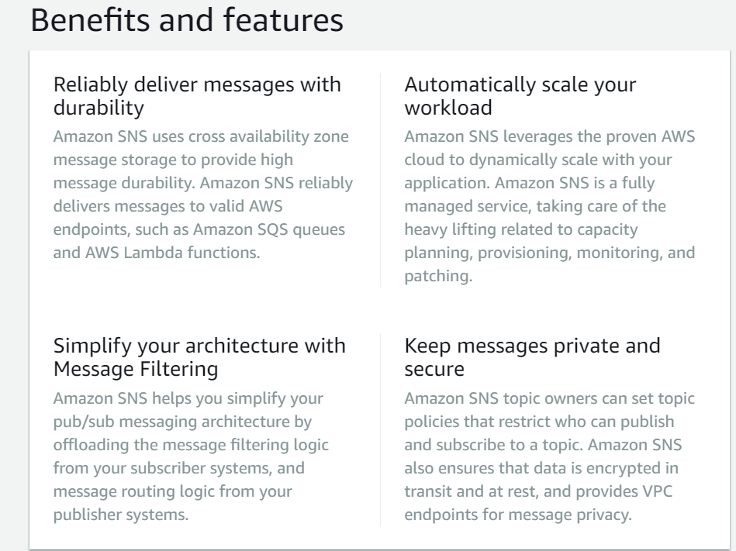

Slide 3


Slide 4


Slide 5


Slide 6
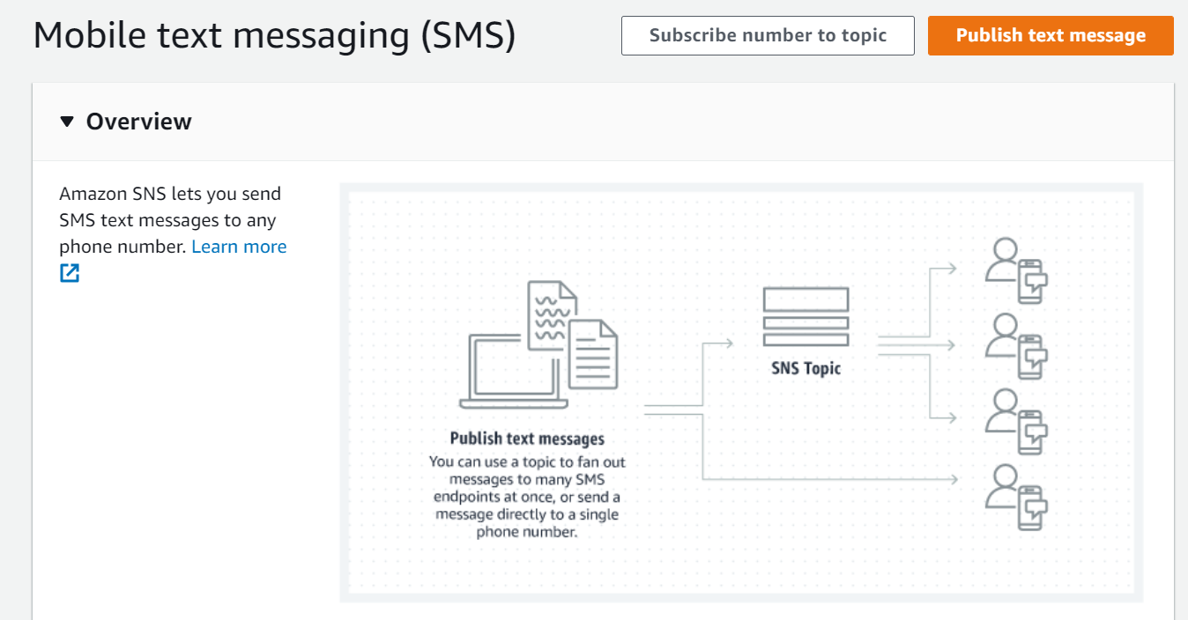
Notes:
https://console.aws.amazon.com/sns/v3/home?region=us-east-1#/homepage

